Slide 1
Incremental Convex Hull

Slide 2
Table of content
Background
Polytopes
Convex Hull lower bound
The incremental method
Geometric properties
Offline algorithm
Online algorithm
Conclusion

Slide 3
Table of content
Background
Polytopes
Convex Hull lower bound
The incremental method
Geometric properties
Offline algorithm
Online algorithm
Conclusion

Slide 4
Reminder
Given $n$ points $\{x_{1},…,x_{n}\}$ in $ℝ^{d}$, the convex hull is defined to be the smallest convex set that contains $\{x_{1},…,x_{n}\}$.
In the previous course we saw how to compute the convex hull in $R^{2}$.

Slide 5
Background
A basic problem in Computational Geometry
For $d=2$ we have few optimal algorithms
For $d≥3$, the problem is considerably more difficult
Notes:
In the problem of a polygonal robot moving amidst polygonal obstacles. The arrangement induces by the obstacles induced cells. We can formalize the reachable location of the robot to be one cell. Because the robot can’t hit an obstacle, it is constrained by the robot to stay in only one cell.
If we divide the points to the equivalence classes of a point is equivalent to another point if the second point is reachable from the first one. So, each class is a cell.

Slide 6
Table of content
Background
Polytopes
Convex Hull lower bound
The incremental method
Geometric properties
Offline algorithm
Online algorithm
Conclusion

Slide 7
Polytopes
Definition: Let $ℝ^{d}$, a polytope is a $d$-dimensional shape which every side is flat. (Meaning that the side is a Euclidean space)
A convex hull of a set of points is a polytope
We would like to represent a polytope in a data structure.

Slide 8
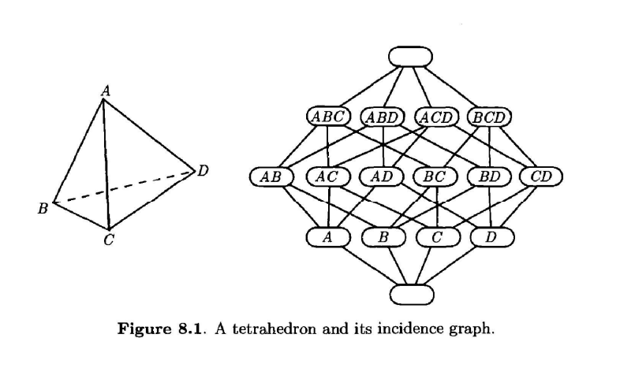
Polytope
We will represent a polytope using the Incidence graph.
Notes:
Each face is a node and there is an edge between two incident faces.
Two faces are incident if they differ with one dimension and one is contained in the other.

Slide 9
Polytope-known facts (without proof)
It is known that a $d$-polytope can be stored using $O\left(n^{\left\lfloor \frac{d}{2}\right\rfloor }\right)$.
There are $n$ points such that their convex hull is a $d$-polytope with a storage complexity of $Ω\left(n^{\left\lfloor \frac{d}{2}\right\rfloor }\right)$.

Slide 10
Table of content
Background
Polytopes
Convex Hull lower bound
The incremental method
Geometric properties
Offline algorithm
Online algorithm
Conclusion

Slide 11
Convex Hull – Lower Bound
Theorem: The complexity of computing the convex hull of $n$ points in $d$ dimensions is $Ω\left(nlogn+n^{\left\lfloor \frac{d}{2}\right\rfloor }\right)$.
Proof:
From the facts, $Ω\left(n^{\left\lfloor \frac{d}{2}\right\rfloor }\right)$ is a trivial lower bound.
In two dimensions, the lower bound is $Ω\left(nlogn\right)$ and you can always project from $ℝ^2$ to $ℝ^{d}$ so it cannot be smaller.

Slide 12
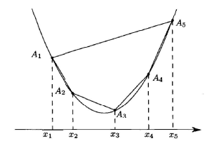
Convex Hull – Lower Bound
Theorem: The problem of sorting $n$ real numbers can be transformed in linear time into the problem of computing the convex hull of $n$ points in $ℝ^{2}$.
Proof:
Given $x_{1},…,x_{n}$.
Compute the convex hull of $\left(x_{1},x_{1}^{2}\right),…,(x_{n},x_{n}^{2})$.
The convex hull is cyclic, and the list of vertices is sorted according to $x_{1},…,x_{n}$.

Slide 13
Table of content
Background
Polytopes
Convex Hull lower bound
The incremental method
Geometric properties
Offline algorithm
Online algorithm
Conclusion

Slide 14
The Incremental Method For Convex Hull
We would like to compute the convex hull in $n$ steps.
In each step we add a new point and compute the convex hull of the already processed points and the new point.
This means that we need to know the last computed convex hull and use it in order to compute the new one.
Again, we will save each convex hull as an incidence graph.

Slide 15
Table of content
Background
Polytopes
Convex Hull lower bound
The incremental method
Geometric properties
Offline algorithm
Online algorithm
Conclusion

Slide 16
The Incremental Method For Convex Hull – Geometric properties
We will reduce the problem for now to the following.
Let $C$ a convex hull of some points and $P$ a new points such that $C$ and $P$ are in general position.
Each facet of $C$ is supported by a hyperplane $H$.
We will color the facet red if $P$ belongs to $H^{−}$ and blue if $P$ belongs to $H^{+}$.
From the general position, every facet gets a color.
Notes:
2) Meaning that the vertices of $C$ and $P$ are in general position.

Slide 17
The Incremental Method For Convex Hull – Geometric properties
Each face in $C$ is the intersection of all the facets that contain it.
So, we can color each face using three colors.
Red if it is the intersection of red facets.
Blue if it is the intersection of blue facets.
Purple else.

Slide 18
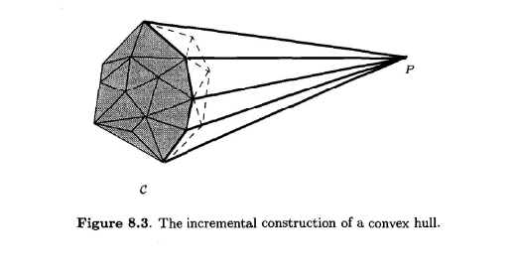
The Incremental Method For Convex Hull – Geometric properties
Notes:
1) Imagine that the point $P$ is a source of light. The red faces are the one which are lit, and the blue faces are the ones that are hidden from the light. The purple faces are the connection points of lit and shadowed.

Slide 19
The Incremental Method For Convex Hull – Geometric properties
Lemma 1: Let $C$ be a polytope and $P$ a point in general position with respect to $C$. Every face of the $conv\left(C∪\{P\}\right)$ is either a blue or purple face of $C$, or $conv\left(G∪\{P\}\right)$ of a purple face $G$ of $C$.
Notes:
1) It is quite intuitive, and you can understand it from the figure.

Slide 20
The Incremental Method For Convex Hull – Geometric properties
Proof:
If $P$ is in $C$ then all the faces are blue, and it is trivial.
We will show that a blue facet $F$ is a facet of $conv\left(C∪\{P\}\right)$. Let $H$ be the supporting hyperplane.
$P$ belongs to $H^{+}$, so $H$ supports $conv\left(C∪\{P\}\right)$ and$conv\left(C∪\{P\}\right)∩H=F≠∅$. So $F$ is a facet of $conv\left(C∪\{P\}\right)$.
Blue face is an intersection of blue facets of $C$ and from what we showed it is also the intersection of facets of $conv\left(C∪\{P\}\right)$, therefore it is a face in $conv\left(C∪\{P\}\right)$.

Slide 21
The Incremental Method For Convex Hull – Geometric properties
We will show that for any purple face $G$ of $C$, $G$ and $conv\left(G∪\{P\}\right)$ are faces of $conv\left(C∪\{P\}\right)$.
There is a red facet of $C$, say $F_{1}$, and a blue facet of $C$, say $F_{2}$, that both contain $G$. Let $H_{1},H_{2}$ the supporting hyperplane accordingly.

Slide 22
The Incremental Method For Convex Hull – Geometric properties
$P$ belongs to $H_{1}^{−}$ that does not contain $C$.
Imagine a hyperplane that rotates around $H_{1}∩H_{2}$ while supporting $C$ along $G$.
We can choose $H$ to pass through $P$.
$H$ supports $conv\left(C∪\{P\}\right)$ and since $conv\left(C∪\{P\}\right)∩H=conv\left(G∪\{P\}\right)$ then $conv\left(G∪\{P\}\right)$ is a face of $conv\left(C∪\{P\}\right)$.
$$P$$
$$G$$
$$H$$
$$H_{1}$$
$$H_{2}$$

Slide 23
The Incremental Method For Convex Hull – Geometric properties
Now let’s take all the faces in $conv(C∪\{P\})$ that contain $G$ where $G$ is purple.
The intersection of a blue face that contains $G$ and $conv(G∪\{P\})$ is $G$
This implies that $G$ is a face.

Slide 24
The Incremental Method For Convex Hull – Geometric properties
Now every hyperplane that supports $conv\left(C∪\{P\}\right)$ is also supporting $C$, unless P is in the intersection of the hyperplane and $conv\left(C∪\{P\}\right)$.
Consequently, any face of $conv\left(C∪\{P\}\right)$ is blue or purple face of $C$, and if it contains $P$ then it is of the form $conv\left(G∪\{P\}\right)$, where $G$ is a purple face of $C$.
Notice that $P$ is also a face and it is obtained by $conv\left(G∪\{P\}\right)$ where $G$ is the empty face which is purple when $P$ does not belong to $C$.

Slide 25
The Incremental Method For Convex Hull – Geometric properties
Lemma 2: Let $C$ a polytope and $P$ a point in general position with respect to $C$
If $F$ and $G$ are two incident faces of polytope $C$ (blue or purple with respect to $P$), then $F$ and $G$ are incident faces of $conv\left(C∪\{P\}\right)$.
If $G$ is a purple face of $C$, then $G$ and $conv\left(G∪\{P\}\right)$ are incident faces of $conv\left(C∪\{P\}\right)$.
If $F,G$ are purple incident faces of $C$, then $conv\left(F∪\{P\}\right)$ and $conv\left(G∪\{P\}\right)$ are incident.
Notes:
1) Show on figure the lemma

Slide 26
The Incremental Method For Convex Hull – Geometric properties
We say that a subset set of a polytope $C$ is connected if it induces a connected subgraph of the adjacency graph of $C$.
Lemma 3: Consider a polytope $C$ and a point $P$ in general position. The set of facets of $C$ that are red with respect to $P$ is connected, and the set of facets of $C$ that are blue with respect to $P$ is also connected.

Slide 27
The Incremental Method For Convex Hull – Geometric properties
Proof:
Proofing for the two-dimension case is quite easy. (using lemma 1)
We assume that $P$ is not in $C$.
Assume in contradiction that it is not connected.
Let $Q,R$ points on two red facets of $C$ that belong to two different connected components.
Let $H$ be the affine 2-space passing through $P,Q,R$.
$C∩H$ is a 2-polytope.
The red edges of $C∩H$ is exactly the intersections of the red facets of $C$ with $H$.
Because $Q,R$ belong to different connected components we will get that the red edges in $C∩H$ is not connected.
In contradiction to the two-dimension case.

Slide 28
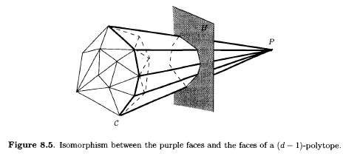
The Incremental Method For Convex Hull – Geometric properties
Lemma 4: Let $C$ a polytope and $P$ a point in general position with respect to $C$. If $C$ has $n$ vertices and does not contain $P$, then the set of the proper faces of $C$ that are purple with respect to $P$ is isomorphic, for the incidence relationship, to the set of faces of a $(d−1)$-polytope whose number of vertices is at most $n$.

Slide 29
The Incremental Method For Convex Hull – Geometric properties
Proof:
From lemma 1 we know that every purple face of $C$ is in $conv\left(C∪\{P\}\right)$.
$P$ is not in $C$ so there exists a hyperplane $H$ that intersects all the faces the contain $P$ but the vertex $P$.
The traces in $H$ of $conv\left(C∪\{P\}\right)$ are the proper faces of the $\left(d−1\right)$-polytope $H∩conv\left(C∪\{P\}\right)$. They also match the incidence relationship of the faces that contain $P$.
From lemma 1 and lemma 2 this subgraph is isomorphic to the subgraph of the incidence graph of purple faces in $C$.
The vertices of the polytope $H∩conv\left(C∪\{P\}\right)$ are the traces in $H$ of the edges of $conv\left(C∪\{P\}\right)$ that are incident to the vertex $P$, and there are at most $n$ of them.

Slide 30
Table of content
Background
Polytopes
Convex Hull lower bound
The incremental method
Geometric properties
Offline algorithm
Online algorithm
Conclusion

Slide 31
Offline algorithm
General idea:
Sort the points in lexicographic order.
Initialize the convex hull of the first $d+1$ points.
Incremental step: compute the convex hull of the first $i$ points knowing the convex hull of the first $i−1$ points that was already computed.

Slide 32
Offline algorithm-details
We will denote $𝔸_{i}$ the convex hull of the first $i$ points.
From the lexicographic order the $i$’th point doesn’t belong to $𝔸_{i−1}$.
From the lemmas that we proved the blue faces in $𝔸_{i−1}$ are also faces in $𝔸_{i}$.
This is where the efficiency comes from.

Slide 33
Offline algorithm-details
We perform the incremental step in 4 phases.
Phase 1: identify a facet of $𝔸_{i−1}$ that is red with respect to the $i$’th point.
Phase 2: the red facets and the red or purple $\left(d−2\right)$-faces of $𝔸_{i−1}$ are traversed. Set them in separate lists.
Phase 3: using phase 2, we identify all the other red or purple faces of $𝔸_{i−1}$. For each dimension $k,d−3≥k≥0$, $R_{k}$ is the red $k$-faces and $P_{k}$ is the purple $k$-faces.
Phase 4: update the incidence graph.

Slide 34
Offline algorithm-Incidence graph
The incidence graph nodes are faces of the polytope and each of them has the following data:
A list of the sub-faces which their dimension is 1 smaller.
A list of the super-faces which their dimension is 1 bigger.
The color of the face in the current step.
A pointer $p$ which will be cleared during phase 4.
If $F$ is a super-face of $G$, then the record of $F$ in $G$ and the record of $G$ in $F$ are linked through a bidirectional pointer.

Slide 35
Offline algorithm-Phase 1
This phase relies on the fact that we put the points in lexicographic order.
This means that the $(i−1)$’th point is always a vertex of $𝔸_{i−1}$.
This also means that there is a facet of $𝔸_{i−1}$ that contain the $(i−1)$’th point which is red with respect to the $i$’th point. (without proof)
All these facets were created in the last incremental step, so it suffices to store them and traverse only them.
Notes:
3) To see the proof of this claim you can look in the course book at page 177.

Slide 36
Offline algorithm-Phase 2
This phase relies on the connectivity of the red faces.
Traverse from the facet that was found in phase 1 over all the facets that are visible from the $i$’th point (and color them red).
Also, traverse all the $(d−2)$-faces.
Color each of those faces red if it is incident to two red facets, or purple if it is incident to a blue facet.

Slide 37
Offline algorithm-Phase 3
Assume inductively that the lists of $P_{k^{′}}$ and $R_{k^{′}}$ are built for $k^{′}≥k+1$.
For each sub-face of a face of $P_{k+1}$ that has not yet been colored color it purple and add it to $P_{k}$.
For each sub-face of a face in $R_{k+1}$ that has not yet been colored, color it red and add it to $R_{k}$.

Slide 38
Offline algorithm-Phase 4
Denote the $i$’th point with $T_{i}$.
Remove all the red faces from the incidence graph and the edges that touch them in the graph.
The purple faces are processed in increasing order of $k$.
For a purple $k$-face $F$, create a new node $conv\left(F,\{T_{i}\}\right)$ and connect it with an edge to $F$.
Set the pointer $p(F)$ to be the new node that was created.
This allows us to connect with an edge all the incident $k$-faces of the form $conv\left(G,\{T_{i}\}\right)$, where $G$ is a $(k−1)$-face incident to $F$.

Slide 39
Offline algorithm-analysis
Phase 1: is proportional to the number of facets that were created at the previous step. The total cost of phase 1 over all the algorithm is dominated by the total facets created.
Phase 2: at each step $i$, it is proportional to the number of red facets of $𝔸_{i−1}$ and their incidences.
Phase 3: is proportional to the number of incidences between red or purple faces of $𝔸_{i−1}$.
Phase 4: is proportional to the total number of red faces and their incidences, plus the number of purple faces and of their incidences to purple faces.
Overall: from this analysis one can understand that the complexity of the algorithm is proportional to the changes that are made upon the incidence graph.

Slide 40
Offline algorithm-analysis
Lemma 5: the number of faces and incidences created during the execution is $O\left(n^{\left\lfloor \frac{d+1}{2}\right\rfloor }\right)$.
Theorem: The incremental algorithm that builds the convex hull of $n$ points in $d$ dimensions in time $O\left(nlogn+n^{\left\lfloor \frac{d+1}{2}\right\rfloor }\right)$ and storage$O\left(n^{\left\lfloor \frac{d}{2}\right\rfloor }\right).$

Slide 41
Table of content
Background
Polytopes
Convex Hull lower bound
The incremental method
Geometric properties
Offline algorithm
Online algorithm
Conclusion

Slide 42
Online algorithm
The algorithm that was presented was offline.
We would like to construct a on-line algorithm.
We will use the randomized technique which we are already familiar with.

Slide 43
Online algorithm-Formalization
The objects are the points.
A region is the union of two open half-spaces made from the points in the following construction.
Let $\{P_{0},P_{1},…,p_{d}\}$ a tuple of $d+1$ points in general position.
Let $H_{d}$ the hyperplane from $P_{0},…,P_{d−1}$ points and $H_{0}$ analogically.
We denote with $H_{d}^{−}$ the half space that does not contain $P_{d}$ and $H_{0}^{−}$ analogically.
The region is $H_{d}^{−}∪H_{0}^{−}$.
A point conflicts a region if it belongs to the region.

Slide 44
Online algorithm-Example for a region in 2d
conflict

Slide 45
Online algorithm-Formalization
The convex hull of a set of $n$ points can be described as the set of all regions without a conflict.
In fact, there is a bijection between those regions and the $(d−2)$-faces of $conv(S)$.
So, we can also get in efficient time the adjacency graph.
Notes:
1) Take the region which is defined by $P_{0},…,P_{d}$ of the region is without conflict then $F_{d}=conv(P_{0},…,P_{d−1})$ and $F_{0}=conv(P,…,P_{d})$ are facets of $conv(S)$. So $G=F_{0}∩F_{d}=conv(P_{1},…,P_{d−1})$ is the $(d−2)$-face of $conv(S)$ that is incident to both facets.

Slide 46
Online algorithm
The algorithm is incremental and is very similar to the offline.
In the offline we took advantage on the ability to sort the points.
Because now we don’t know the order of the insertion of the points, we will maintain an influence graph.

Slide 47
Online algorithm-influence graph
As we recall it is used mainly to detect the conflicts between the point to be inserted and already defined regions.
Each node of the graph is a region, that at some previous step, appeared as a region and without conflict over the current subset of points.
The last nodes that were created can be found in the leaves.

Slide 48
Online algorithm
Using the influence graph, we can easily find all the facets that are red with respect to $P$.
A region that conflicts with $P$ corresponds to a red or purple $(d−2)$-face. Because one of the facets makes it red.
If a region is not conflicting $P$ then it corresponds to a blue $(d−2)$-face.

Slide 49
Online algorithm
Initialize: from the first $d+1$ initialize the incidence graph and the influence graph
The incremental step is done in two phases.
Denote $S$ to be the convex hull until now and $P$ the new point.

Slide 50
Online algorithm-Phase 1
We want to locate all the regions that conflicts with $P$.
To do that we recursively visit all the nodes in the influence graph that conflicts with $P$, starting from the root.

Slide 51
Online algorithm-Phase 2
If there are no conflicts, then $P$ is in $conv(S)$ and there is nothing to do.
If there is a conflict, then we can find a red facet and continue according to the phases of the offline algorithm.
We just need to know how to update the influence graph.

Slide 52
Online algorithm-Phase 2 Updating the influence graph
This is also done in two phases.
First, we consider only the purple $(d−2)$-faces of $conv(S)$.
Let $G$ such face and let ${(F}_{1},F_{1}^{′})$ the corresponding region.
Assume that $F_{1}$ is blue and $F_{1}^{′}$ is red.
We denote $F_{1}^{′′}$ to be $conv(G∪\{P\})$.
So now $G_{}$is a $(d−2)$-face of $conv(S∪\{P\})$ corresponding to $(F_{1},F_{1}^{′′})$.

Slide 53
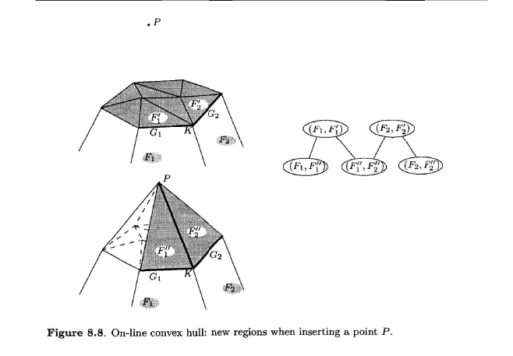
Online algorithm-Phase 2 Updating the influence graph
So, add $(F_{1},F_{1}^{′′})$ to the influence graph and hook him as the child of $(F_{1},F_{1}^{′})$

Slide 54
Online algorithm-Phase 2 Updating the influence graph
Now we consider only the purple $(d−3)$-faces of $conv(S)$ that are contained in at least two different purple $(d−2)$-faces.
Let $K$ such face and $G_{1},G_{2}$ be the purple $(d−2)$-face of $conv(S)$ that are incident to $K.$
Let $\left(F_{1},F_{1}^{′}\right),(F_{2},F_{2}^{′})$ be the regions. $F_{1},F_{2}$ are blue and $F_{1}^{′},F_{2}^{′}$ are red.
$conv(K∪\{P\})$ is a $(d−2)$-face of $conv(S∪\{P\})$ and is incident to $F_{1}^{′′},F_{2}^{′′}$. So add a new node in the influence graph for $(F_{1}^{′′},F_{2}^{′′})$ and hook it with $\left(F_{1},F_{1}^{′}\right),(F_{2},F_{2}^{′})$.

Slide 55
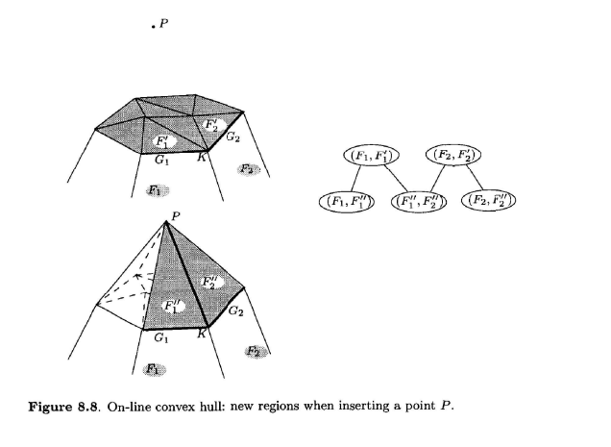
Online algorithm-Phase 2 Updating the influence graph

Slide 56
Analysis of the online algorithm
According to the method we are using to analyze the algorithm one need to satisfy the following:
Testing conflict between a point and a region can be done in constant time.
The number of children for each node in the influence graph is bounded.
The parents of a node that was created in the insertion of $P$ are the regions that were killed by $P$.
One can check that everything holds so we get the following results.

Slide 57
Analysis of the online algorithm
The number of regions without conflict defined over $S$ is exactly the $(d−2)$ faces of the convex hull which is $O\left(n^{\left\lfloor \frac{d}{2}\right\rfloor }\right)$.
Theorem: The online algorithm is running in expected time of $O\left(nlogn+n^{\left\lfloor \frac{d}{2}\right\rfloor }\right)$ and storage $O\left(n^{\left\lfloor \frac{d}{2}\right\rfloor }\right)$. The expected time required to perform the $n$-th insertion is $O\left(logn+n^{\left\lfloor \frac{d}{2}\right\rfloor −1}\right)$.

Slide 58
Table of content
Background
Polytopes
Convex Hull lower bound
The incremental method
Geometric properties
Offline algorithm
Online algorithm
Conclusion

Slide 59
Conclusion
We saw few geometric properties of the convex hull.
An offline algorithm to compute the convex hull.
An online algorithm to compute the convex hull.
The online algorithm is a semi-dynamic algorithm.
There is also a full dynamic algorithm to compute the convex hull.

Slide 60
Questions?

